Slide 1

Red Hat - Infrastructure Monitoring Solution
Solution Architecture Discussion and Demo
Ted Craig
Account Executive - IRS
Steven Woodward
Domain Architect
Process and Decisions Automation
Nimish Rawal
Cloud Solutions Specialist - IRS

Slide 2
Agenda
Introductions
Current State As we understood
Proposed Architecture
Red Hat Decisions Manager
Red Hat Integration
Solution Demo - Focused on Decisions Manager
Next Steps

Slide 3
Current State
System Impacted
Monitoring Systems
Research Impact and Notify - Manual Process
Master
File
SNMP
Trap
RUP
Other

Slide 4
Current State - Complex System Dependency
*Hypothetical Dependencies
RRP
RUP
MeF
CADE2
IDRS
EUP
AUR
Master
File
AIR
CFOL

Slide 5
Current State
Difficult to understand the Impact when systems or interfaces are down
Difficult to notify in case of complex dependencies
Impact on productivity
Resources and time spent on understanding the outages or false positives - manual process - Hours spent on conf. calls

Slide 6
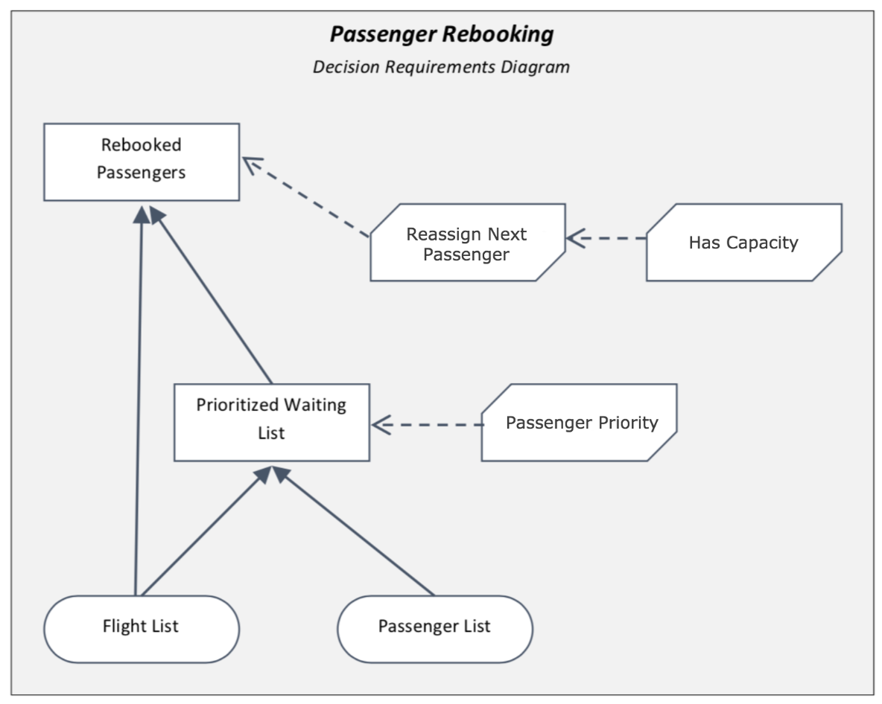
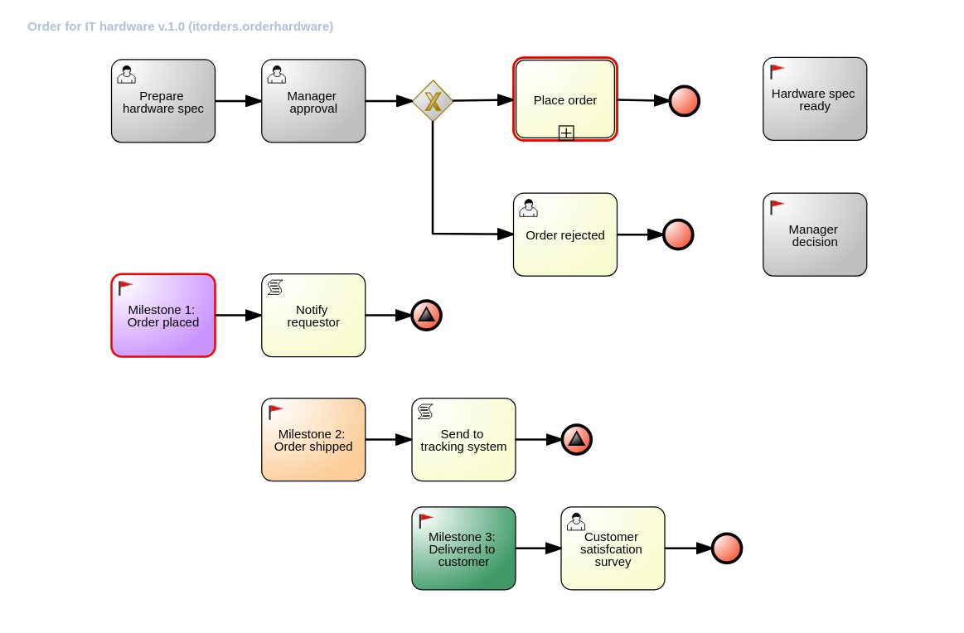
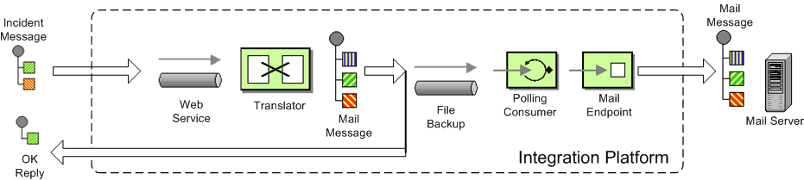
Proposed Solution Architecture
System Impacted
Red Hat Integration
Decisions Manager - System Impact Rules
Process Automation Manager or ITSM
SNMP
Master
File
Logs
RUP
Connectors - File, SNMP, Database - 200+
Messaging (Kafka, JMS)
Fuse - Camel Routes to invoke Rules
DB
Business Rules
Decisions Model
Decisions Table
Streamline IT processes
Manage workflows
Orchestrate Rules
Other
OpenShift Container Platform and Container Storage

Slide 7
Focus for this Meeting
System Impacted
Red Hat Integration
Decisions Manager - System Impact Rules
Process Automation Manager or ITSM
SNMP
Master
File
Logs
RUP
Connectors - File, SNMP, Database - 200+
Messaging (Kafka, JMS)
Fuse - Camel Routes to invoke Rules
DB
Business Rules
Decisions Model
Decisions Table
Streamline IT processes
Manage workflows
Orchestrate Rules
Other
OpenShift Container Platform and Container Storage

Slide 8
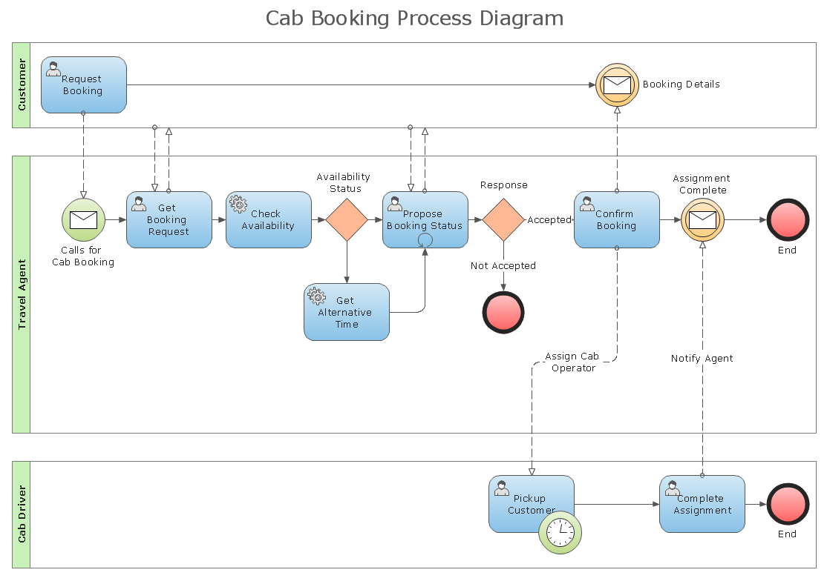
Monitoring Business Processes and Transactions in your organization
Transaction or Business Process State and Alerts in the event it’s not executed
Fuse/Camel provides transformation and triggers/executes processes or business rules
Fuse/Camel
Messaging Provides - FIFO based processing for Logs/Events
Messaging
Monitoring Events from Mainframe and other systems
RUP
CADE2
RRP
MeF
IDRS
EUP
Master
File
AUR
AIR
CFOL

Slide 9
Red Hat Decisions Manager - part of Process Automation Manager
Low Code rules, processes and application development platform

Slide 10
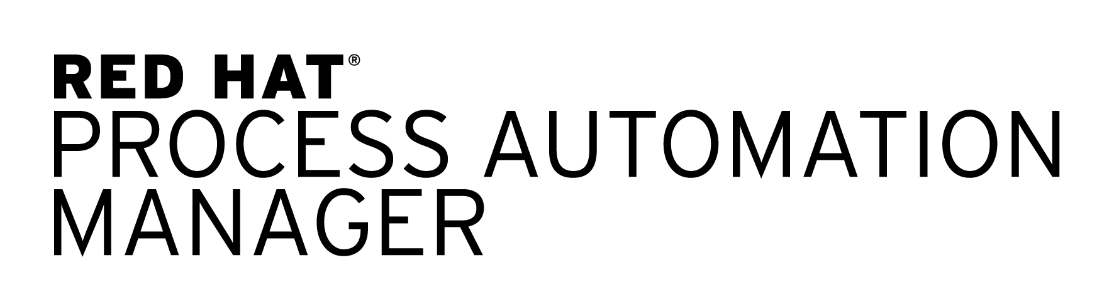
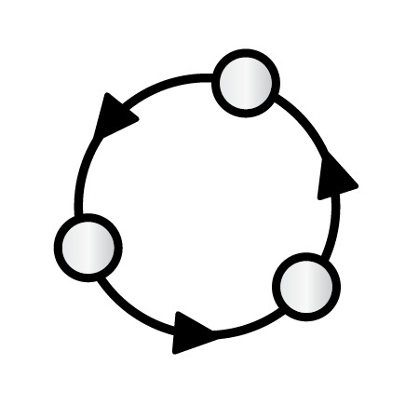




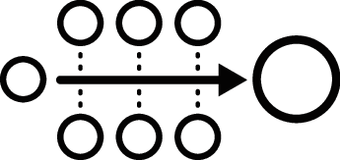
PROCESS AUTOMATION MANAGER
Key features
Complex event processing
Business rules
Business optimization
Process/Case
management
Entando UX platform

Slide 11
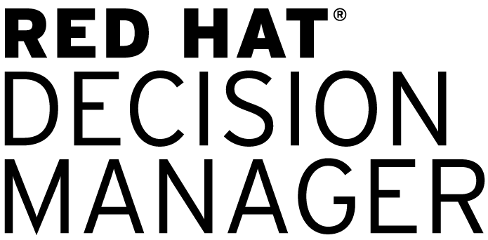
PROCESS AUTOMATION MANAGER
Key features
Complex event processing
Business rules
Business optimization
Process/Case
management
Entando UX platform

Slide 12
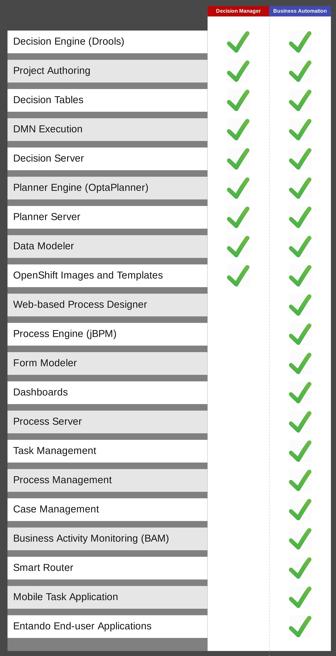
COMPARED TO

Slide 13
WHAT DO BUSINESS PROCESS MODEL LOOKS LIKE?
Key features

Slide 14

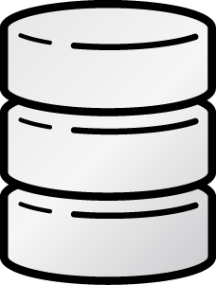

Rule Authoring
Tools for business experts
APPS
APPS
APPS
Client app
RULES
Decision services
Tools for developers
Business central
Decision server

Slide 15
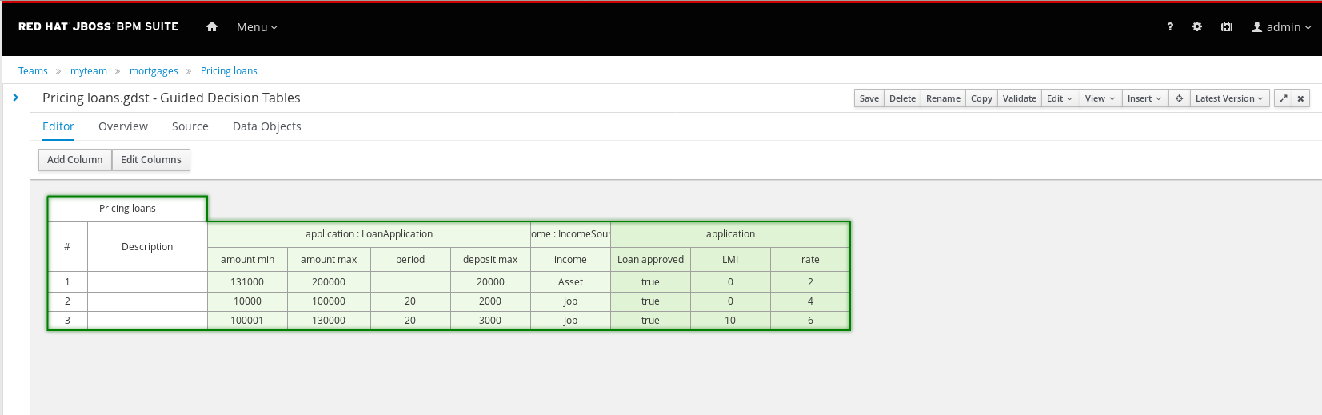
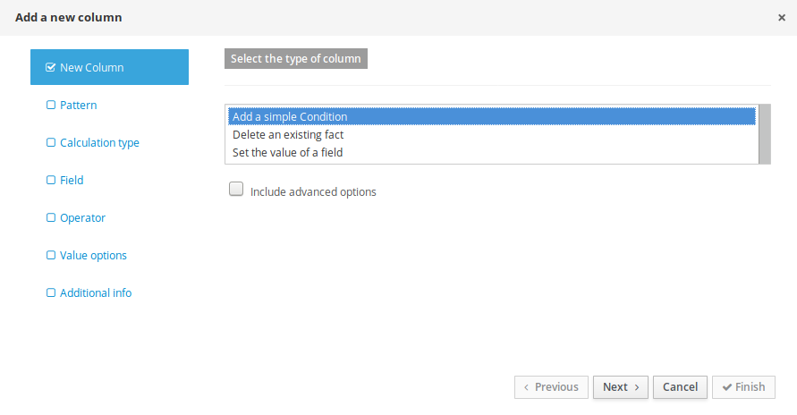
Tools for Business Experts - Decision Table

Slide 16
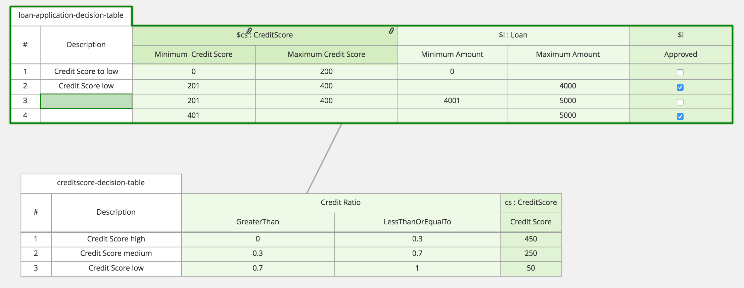
Tools for Business Experts - Decision Graph

Slide 17
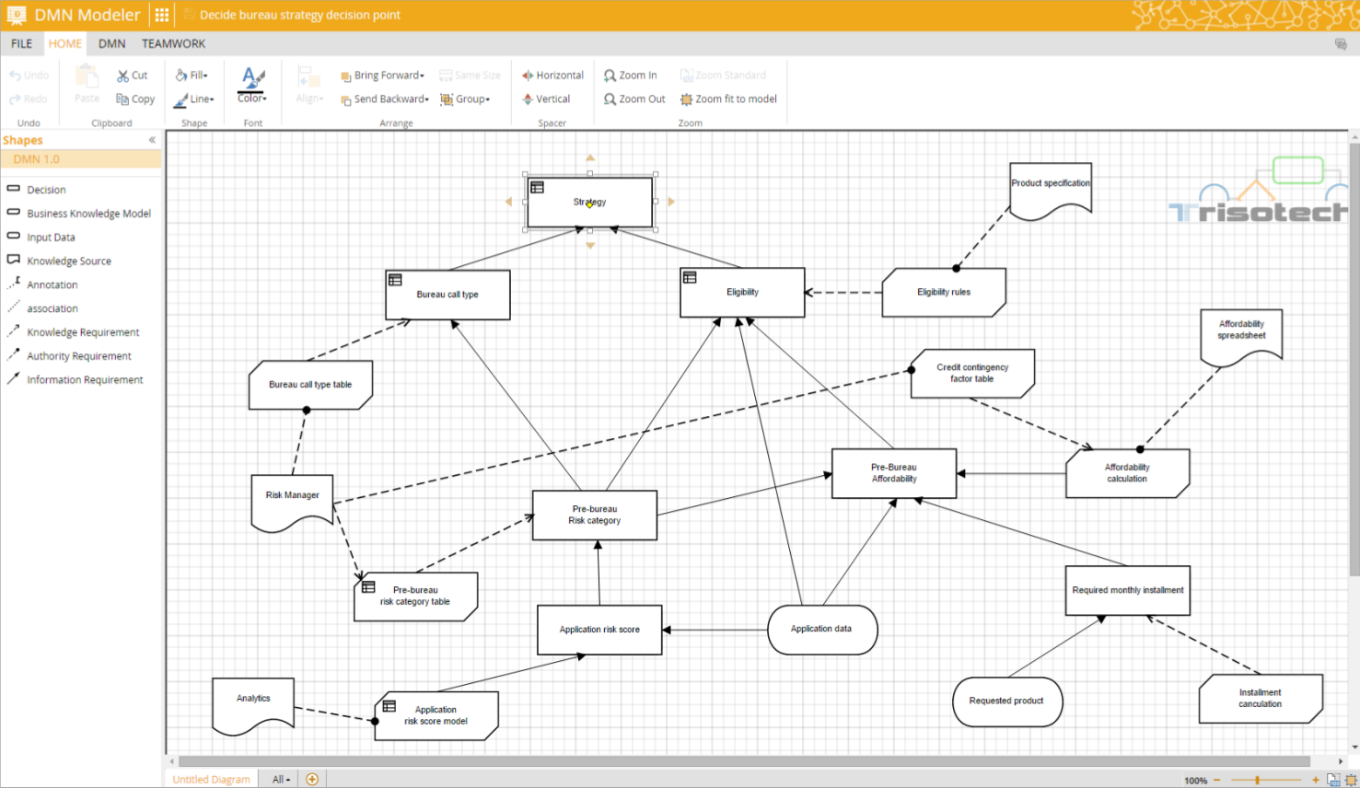
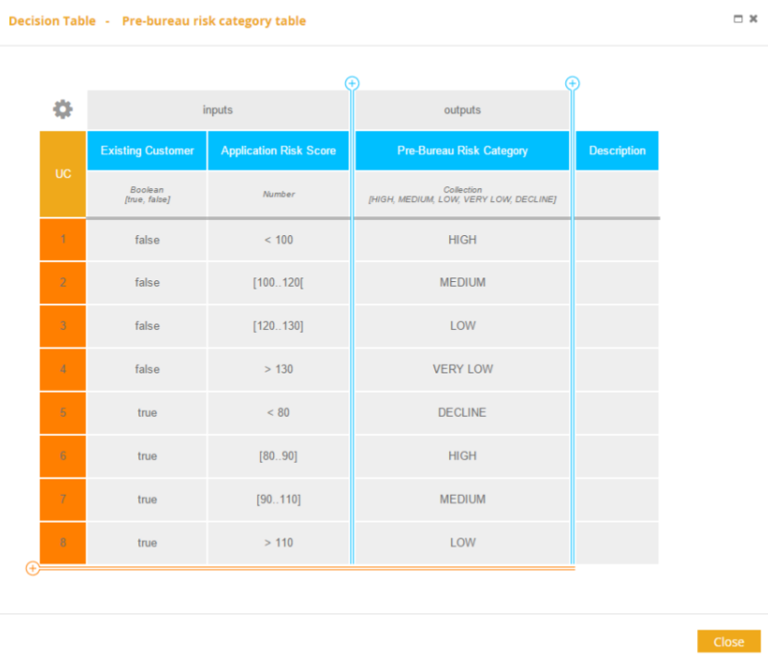
Tools for Business Experts - Trisotech DMN Modeler

Slide 18
Red Hat Integration
Connect applications, transform data, design, build and govern APIs

Slide 19



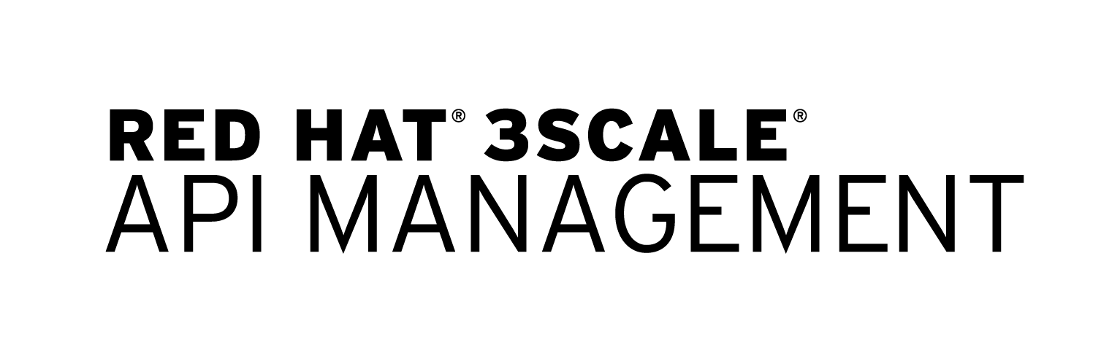


Slide 20

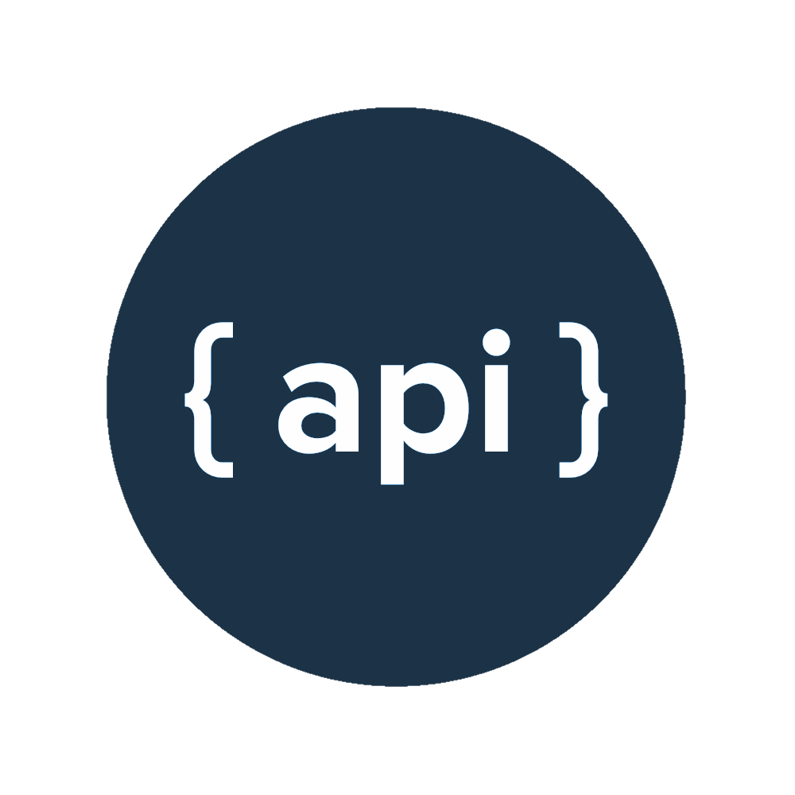
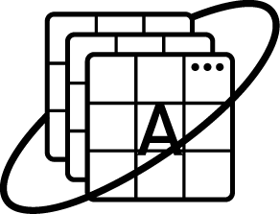

API-LED DEVELOPMENT LIFECYCLE
Build and Manage
Services
and APIs
Cloud, Mobile, and
IoT Application
Development
Manage
Orchestrate and manage APIs and services at scale
Monitor Optimize API and app performance with analytics
Secure
Protect APIs and
services from threats
and vulnerabilities
Consume Enable secure, scalable use of APIs in apps
Test | Publish Test and publish APIs to target environments
Develop Accelerate development
with app services, runtimes, and certified images
Publish
Consume
Create Build APIs and services with EIPs
and integrated tools
Discover Help developers find and integrate APIs easily
Design Strategize, design, prototype APIs and services
Build and manage APIs and services rapidly for your next gen architectures
Develop secure apps for
Mobile, Cloud and IoT faster
Full Lifecycle
Notes:
There is a need for tools for the entire lifecycle of API-led development
From designing and creating the apis
Building and managing the services and APIS
To other devs having the ability to consume the APIs you’ve developed and build ecosystems around it
Plus finally being able to monitoring the usage

Slide 21
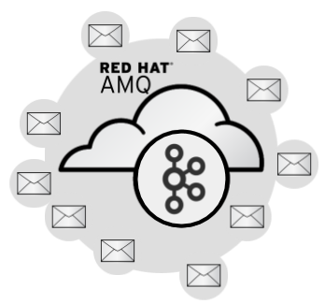
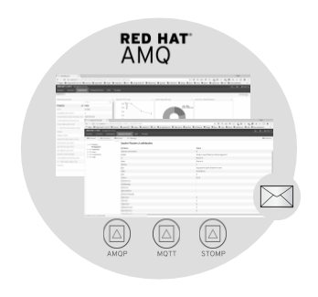

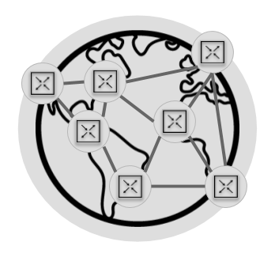
RED HAT AMQ
Pure-Java multiprotocol message broker - provides fast message persistence and advanced HA modes.
Supports C++, Java, JavaScript, Python, Ruby, and .NET applications, as well as Linux, Windows, and JVM-based environments.
Implements JMS 1.1, 2.0 API, AMQP 1.0, MQTT, and WebSocket.
Small-footprint - broker can be deployed standalone or in a Java EE container.
Massively scalable, distributed, and high performance data streaming platform.
AMQ Streams - based on Apache Kafka provides an event streaming backbone … simplifies deploying Kafka on Kubernetes.
SCALABLE MESSAGING
LIGHTWEIGHT DISTRIBUTED
Notes:
Choose the right messaging for your application
Broker
Problem: How to gain insight across multiple applications?
Solution: Messaging can deliver information from any source to any destination
Kafka
Apache Kafka is a distributed system designed for streams. It is built to be fault-tolerant, high-throughput, horizontally scalable, and allows geographically distributed data streams and stream processing applications.
We simplify how to operate a distributed kafka cluster on kubernetes
Interconnect
Problem: How can I deliver a stream of vital data to geographically/network/organizationally dispersed consumers?
Solution: Messaging augmented with sophisticated routing can reach consumers simply and reliably

Slide 22
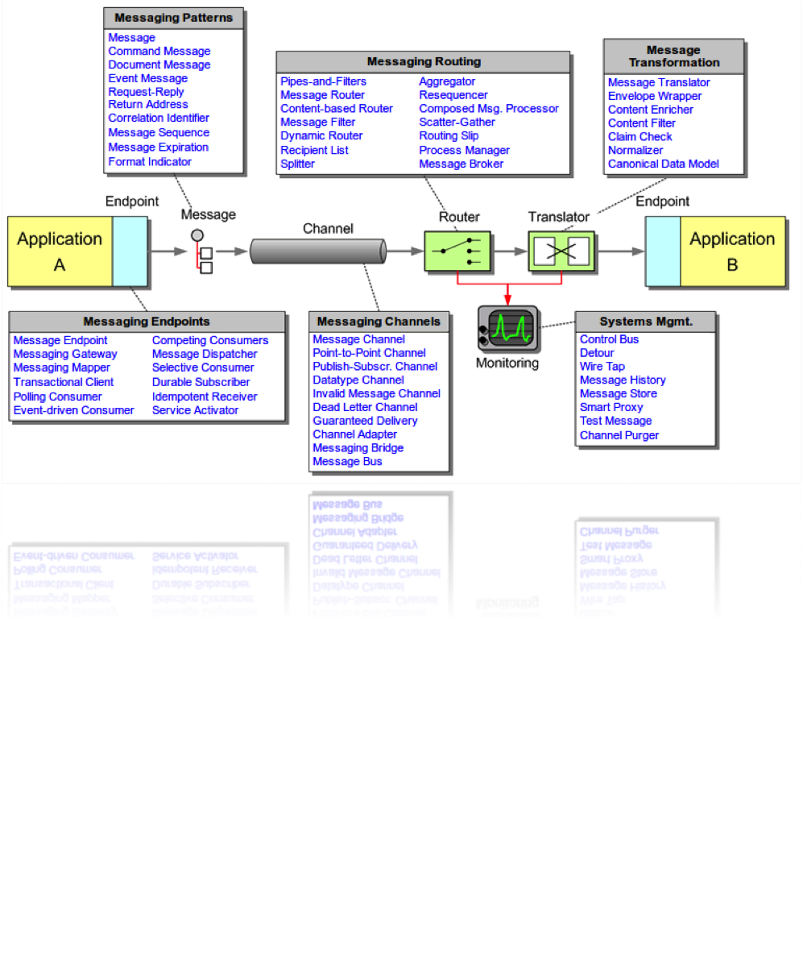
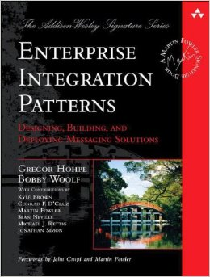

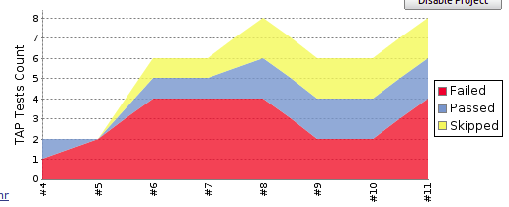

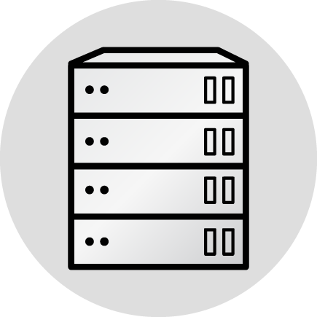



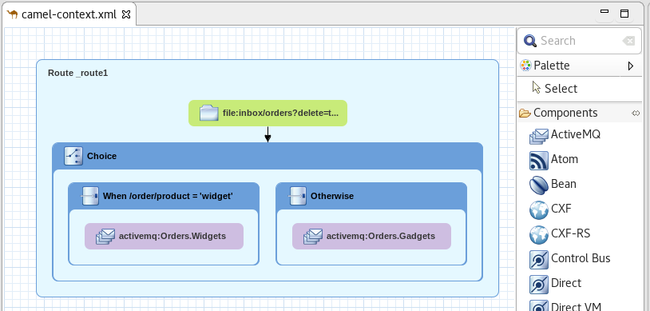
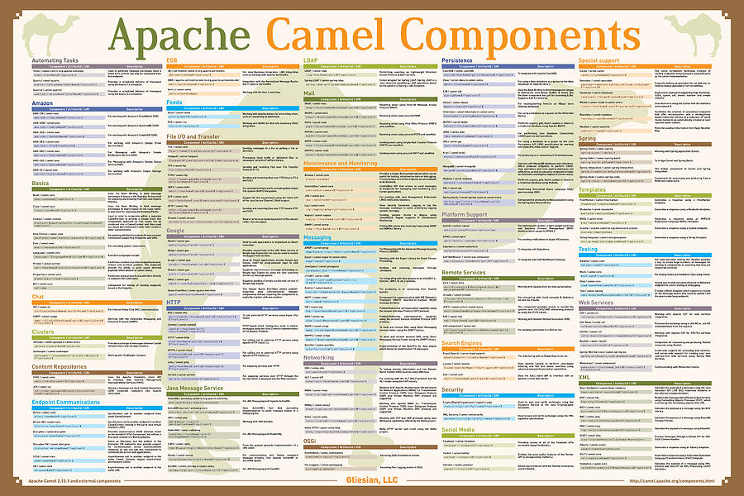
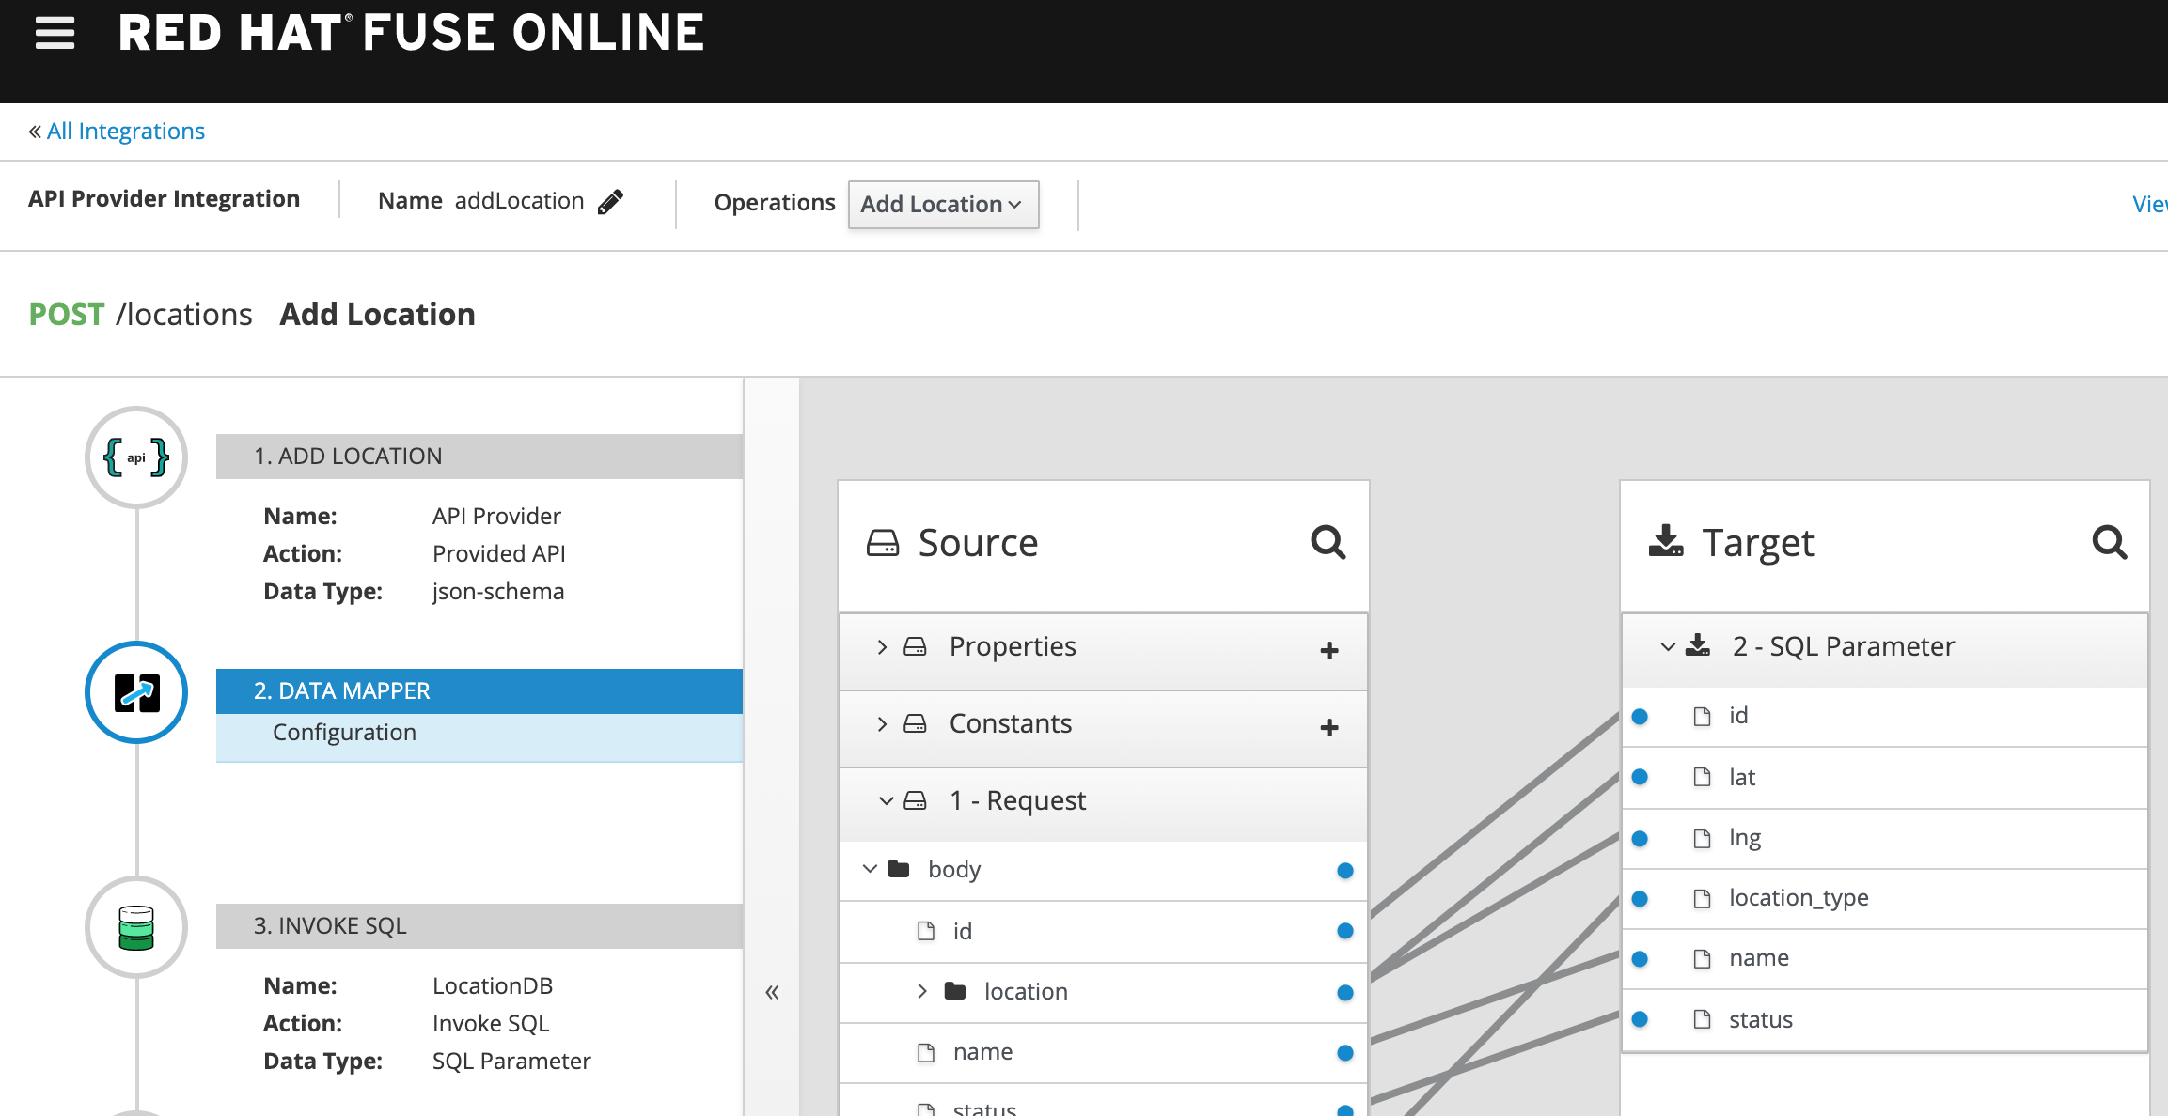
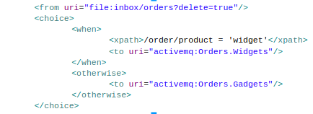
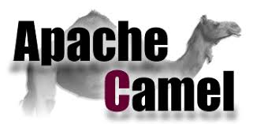
RED HAT FUSE
65 Integration Patterns
Lightweight Integration Framework
Run as standalone, in public,
or private cloud
Flexible & Standard
Java Maven Projects
Advanced Testing Framework
DISTRIBUTED INTEGRATION
Ensure robustness against system failure
Service and Flow Design
(Graphical & Code)
+200 Connectors and Dataformats
Built-in iPaaS for Low-Code Integrations
FLEXIBILITY

Slide 23

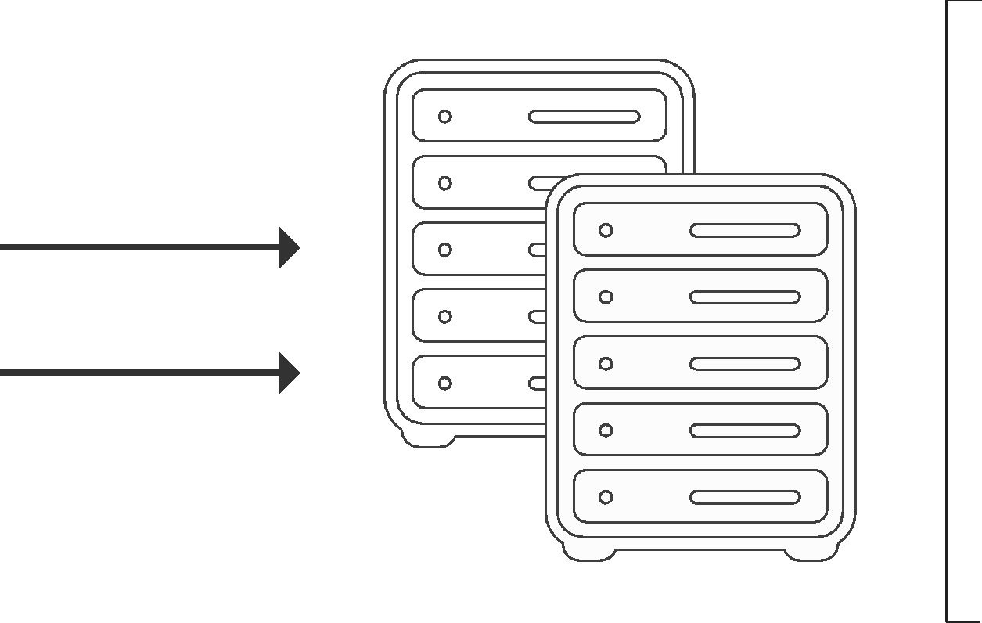
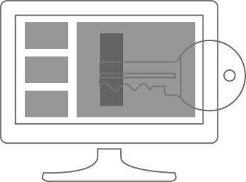
RED HAT 3SCALE API MANAGEMENT
Traffic control, security, and access policy enforcement on-premise or in the cloud.
API usage analytics,
RBAC, self-service developer workflows.
Automated, containerized, support for hybrid environments.
Fuse and OpenShift integration - simplify API development and deployment.
API-FIRST
DESIGN
Multiple authentication mechanisms
API Key
App ID / App Key
OpenID Connect
Authenticate traffic
Restrict by policy
Drop unwelcome calls
Protect backend services
Generate overage alerts
Impose rate limits
RE-USE
Supports a variety of encryption, authentication, and authorization protocols.
Notes:
As you start to build and expose APIs
You need a way to manage them. This includes
authentication/authorization - who can use them
Traffic control/policy - defining what they can access
Being able to monitor the usage and see which APIs are being used

Slide 24
Solution Demo
Rules to show impact analysis

Slide 25
Proposed Solution Architecture
System Impacted
Red Hat Integration
Decisions Manager - System Impact Rules
Process Automation Manager or ITSM
SNMP
Master
File
Logs
RUP
Connectors - File, SNMP, Database - 200+
Messaging (Kafka, JMS)
Fuse - Camel Routes to invoke Rules
DB
Business Rules
Decisions Model
Decisions Table
Streamline IT processes
Manage workflows
Orchestrate Rules
Other
OpenShift Container Platform and Container Storage

Slide 26








Red Hat App Services on OpenShift
Modernize and innovate at your own pace
BUILD & MIGRATE APPS
COMPOSE & INTEGRATE APPS
AUTOMATE & OPTIMIZE BUSINESS PROCESSES & RULES
Create, run and maintain traditional and cloud-native apps for on-premise, cloud or hybrid architectures
PHYSICAL
VIRTUAL
PRIVATE CLOUD
PUBLIC CLOUD
Notes:
Red Hat Middleware offers a portfolio of products and components to create, integrate and automate modern business applications and processes, optimized for containers and OpenShift, for on-premise, cloud or hybrid architectures.
Combined with OpenShift, this becomes a full portfolio, flexible for heterogeneous environments which support building net new, supporting 3rd party vendors and coexisting and integrating with existing applications, services and data.
Census already has runtimes + integration

Slide 27
Next Steps

Slide 28
Thank you
Ted Craig
Account Executive
703-929-4685
tcraig@redhat.com
Nimish Rawal
Solutions Specialist
202-412-5973
nrawal@redhat.com

Slide 29
Monitoring Business Processes and Transactions in your organization
Transaction or Business Process State and Alerts in the event it’s not executed - Dashboard for End users
Fuse/Camel provides transformation and triggers/executes processes or business rules
Fuse/Camel
Messaging Provides - FIFO based processing for Logs/Events
Messaging
Monitoring Events from Mainframe and other systems
RUP
CADE2
RRP
MeF
IDRS
EUP
Master
File
AUR
AIR
CFOL

Slide 30
IRS BPM demo systems flow
RUP
CADE2
RRP
MeF
IDRS
EUP
Master
File
AUR
AIR
CFOL

